Slide 1
Judicial Review
Dr. Waris Husain
For the Attorney General’s Office

Slide 2
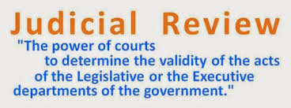

Slide 3
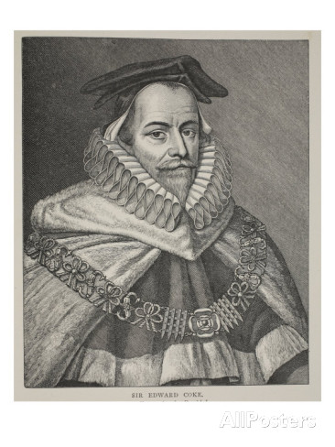
Early history of Judicial Review
Chief Justice Lord Coke in Dr. Bonham’s Case, 1610
“And it appears in our books, that in many cases, the common law will control Acts of Parliament, and sometimes adjudge them to be utterly void;
for when an act of Parliament is against common right and reason, or repugnant, or impossible to be performed, the common law will control it, and adjudge such an Act to be void…”
Notes:
Lord Coke- “And it appears in our books, that in many cases, the common law will control Acts of Parliament, and sometimes adjudge them to be utterly void;
for when an act of Parliament is against common right and reason, or repugnant, or impossible to be performed, the common law will control it, and adjudge such an Act to be void…”
Alexander Hamilton- It, therefore, belongs to the Court the right to ascertain the constitution’s meaning, as well as the meaning of any particular act proceeding from the legislative body.
Marbury v. Madison-

Slide 4
Early history of Judicial Review
Chief Justice Lord Coke in Dr. Bonham’s Case, 1610
“And it appears in our books, that in many cases, the common law will control Acts of Parliament, and sometimes adjudge them to be utterly void;
for when an act of Parliament is against common right and reason, or repugnant, or impossible to be performed, the common law will control it, and adjudge such an Act to be void…”
Notes:
Lord Coke- “And it appears in our books, that in many cases, the common law will control Acts of Parliament, and sometimes adjudge them to be utterly void;
for when an act of Parliament is against common right and reason, or repugnant, or impossible to be performed, the common law will control it, and adjudge such an Act to be void…”
Alexander Hamilton- It, therefore, belongs to the Court the right to ascertain the constitution’s meaning, as well as the meaning of any particular act proceeding from the legislative body.
Marbury v. Madison-

Slide 5
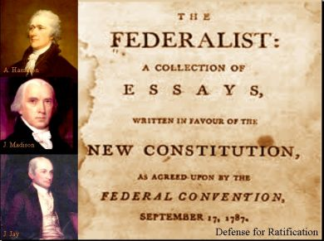
Early history of Judicial Review
Federalist Papers 78:
Alexander Hamilton- It, therefore, belongs to the Court the right to ascertain the constitution’s meaning, as well as the meaning of any particular act proceeding from the legislative body.
Notes:
Lord Coke- “And it appears in our books, that in many cases, the common law will control Acts of Parliament, and sometimes adjudge them to be utterly void;
for when an act of Parliament is against common right and reason, or repugnant, or impossible to be performed, the common law will control it, and adjudge such an Act to be void…”
Alexander Hamilton- It, therefore, belongs to the Court the right to ascertain the constitution’s meaning, as well as the meaning of any particular act proceeding from the legislative body.
Marbury v. Madison-

Slide 6
U.S. Judicial Review
The court’s right to review actions of executive agencies and Congress is NOT in the constitution, why?
The perception of lawyers during colonial era-America was very negative.
Court was given narrow and limited powers in the Constitution to limit the power of judges and lawyers- vesting real powers in Congress and President.

Slide 7
Major U.S. Judicial Review Cases
Marbury v. Madison- Appointment of judges by the President.
"It is emphatically the province and duty of the judicial department to say what the law is. Those who apply the rule to particular cases, must of necessity expound and interpret that rule. If two laws conflict with each other, the courts must decide on the operation of each."

Slide 8
U.S. Judicial Review Cases: Federalism
Gibbons v Ogden: 1824
Ogden held a New York State license allowing him to operate a ferry across the Hudson between New York and New Jersey. Gibbons received a Federal license and claimed that his license superceded that of Ogden.
The court ruled that Gibbon's federal license took precedence over that of Ogden because the federal government was given the power to regulate interstate trade.

Slide 9
Judicial Review: Federalism Cases
McCulloch v Maryland: 1818
Angered by the existence of the new Federal bank, the state of Maryland decided to tax the bank. McCulloch, a cashier for the bank refused to pay the tax claiming. The Supreme Court affirmed that a state had no power or right to tax the federal government. This precedent established the superiority of the federal government.

Slide 10
Judicial Review: Federalism Cases
Murphy v. National Collegiate Athletic Association: 2018
Professional and Amateur Sports Protection Act, a federal law that banned states from legalizing sports betting, thus giving oversight of gambling to the individual states.
The issue was whether the U.S. federal government has the right to control state lawmaking.
. Justice Samuel Alito, in writing the majority opinion, stated that PASPA “unequivocally dictates what a state legislature may and may not do. … State legislatures are put under the direct control of Congress. It is as if federal officers were installed in state legislative chambers and were armed with the authority to stop legislators from voting on any offending proposals. A more direct affront to state sovereignty is not easy to imagine.”

Slide 11
Judicial Review: Federalism Cases
South Dakota v. Wayfair, Inc., 585 U.S. ___ (2018), INTERNET SALES AND FEDERALISM
A United States Supreme Court case in which the court held by a 5-4 majority that states may charge tax on purchases made from out-of-state sellers, even if the seller does not have a physical presence in the taxing state.

Slide 12
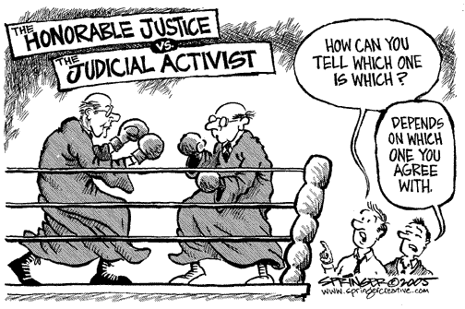

Slide 13
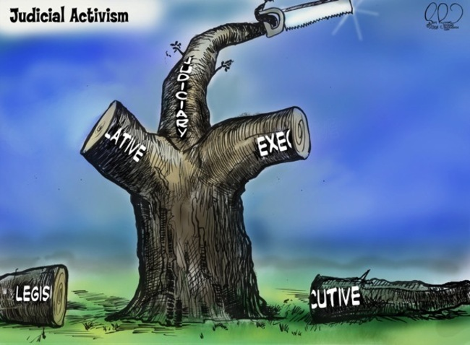

Slide 14
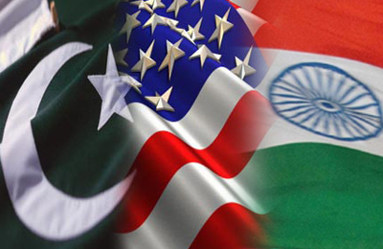
Comparative View

Slide 15
Founders’ Envisioned Role for the Judiciary
 | Constitution of Pakistan | Constitution of India | U.S. Constitution
Types of Jurisdiction | Original, Appellate & Advisory | Original, Appellate & Advisory | Very Limited Original & Appellate
Judicial Review Powers | Expansive | Expansive | Limited

Slide 16
Founders’ Envisioned Role for the Judiciary
 | Constitution of Pakistan | Constitution of India | U.S. Constitution
Types of Jurisdiction | Original, Appellate & Advisory | Original, Appellate & Advisory | Very Limited Original & Appellate
Judicial Review Powers | Expansive | Expansive | Limited
Jurisdictional Clause | Article 184- The Supreme Court shall…have original jurisdiction in any disputes between any two or more governments and cases that the Court considers pose a question of public importance with reference to the enforcement of any of the Fundamental Rights. | Article 32- The right to move the Supreme Court by appropriate proceedings for the enforcement of the (fundamental constitutional rights) rights conferred by this Part is guaranteed. | Article 3, Section 2- Judicial power of the Supreme Court shall extend to cases involving: treaties, ambassadors, maritime jurisdiction, controversies between states and their citizens, controversies between a citizen of the United States and a foreign state

Slide 17
Justiciability Standards & Procedures
 | Pakistan | India | United States
Standards for the exercise of judicial review | - Matter of public importance - For the “enforcement of a fundamental right” - Public interest litigation sets aside standing requirements - Supreme Court Chief Justice exercises suo motu powers to call parties to the court | - Matter of public importance - For the “enforcement of a fundamental right” - Public interest litigation sets aside standing requirements - Sufficient Interest Test | - “Case or Controversy” - Standing - Ripeness & Mootness - Political Question Doctrine

Slide 18
Justiciability Standards & Procedures
 | Pakistan | India | United States
Standards for the exercise of judicial review | - Matter of public importance - For the “enforcement of a fundamental right” - Public interest litigation sets aside standing requirements - Supreme Court Chief Justice exercises suo motu power | - Matter of public importance - For the “enforcement of a fundamental right” - Public interest litigation sets aside standing requirements - Sufficient Interest Test | - “Case or Controversy” - Standing - Ripeness & Mootness - Political Question Doctrine
Procedure | No formal case-selection procedure, most applications must be heard by a 2-judge bench | - Two days per week Court meets to conduct admissions hearings. Admission hearings. The Court can 1) dismiss the petition for lack of merit, 2) issue a summary disposition with a final order, 3) or refer the matter for oral hearing before another bench as a “regular matter.” | - One day per week the Court meets to determine which cases will be granted hearings through writ of certiori. - Rule of Four applies where if four justices agree the case presents a justiciable issue, it is scheduled to be argued before the Court.

Slide 19
Justiciability Statistics
 | Pakistan | India | United States
Number of Justices | 19 | 31 | 9
Petitions Per Year | 18,000 | 47,000 | 7,000 - 8,000

Slide 20
Justiciability Statistics
 | Pakistan | India | United States
Number of Justices | 19 | 31 | 9
Petitions Per Year | 18,000 | 47,000 | 7,000 - 8,000
Current Backlog of Cases | 23,000 | 64,000 | 0

Slide 21
Justiciability Statistics
 | Pakistan | India | United States
Number of Justices | 19 | 31 | 9
Petitions Per Year | 18,000 | 47,000 | 7,000 - 8,000
Current Backlog of Cases | 23,000 | 64,000 | 0
Percentage of Hearings Granted | Most petitions are scheduled for hearings. | 15- 26% | 1%

